Slide 1

R-Trees
-Shubham Vishwakarma
-Kaustubh Dandegaonkar -Himanshu Jindal

Slide 2
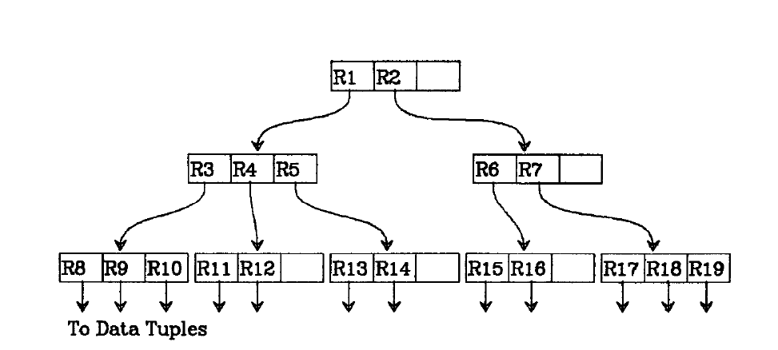
What is an R Tree?

Slide 3
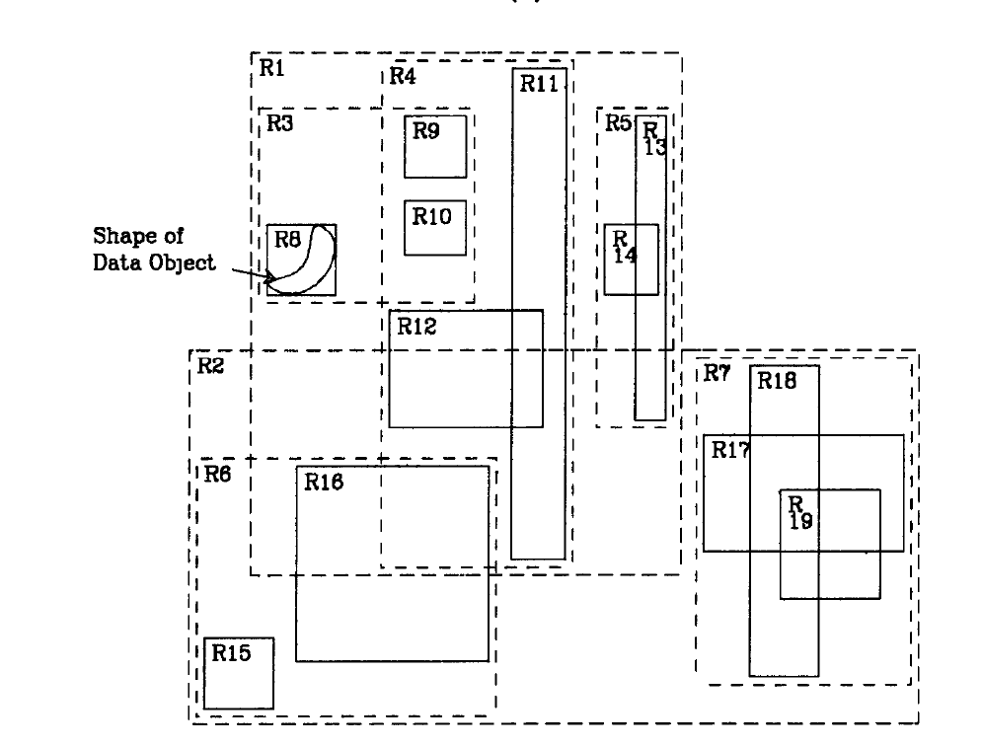

Slide 4
What is an R Tree?

Slide 5
R-Trees
R tree is a tree of Rectangles(hence the name “R” tree), where each Rectangle houses a collection of sub-rectangles.
In the base case the rectangle has collection of points, these rectangles are called Leaf nodes.
The rectangles are tightly bound to ensure maximum utilisation of space, hence named Minimum Bounding Rectangles.

Slide 6
Lets make an R-Tree here
R1
L=[x1,x2…….xN]
y2
R14
R=[y2,y2 …….yN]
R12
R11
Xi is lowerbound in i-th dimension
Yi is upperbound in i-th dimension
Children=[R11,R12,R13,R14]
x2
R13
x1
y1

Slide 7
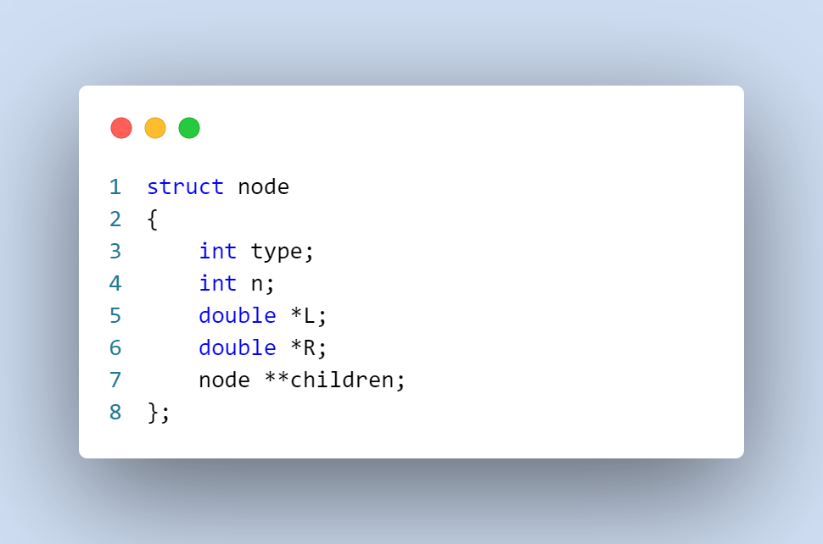
Representation of Rectangles in code

Slide 8
Insertion in R Tree

Slide 9
Splitting Rectangles

Slide 10
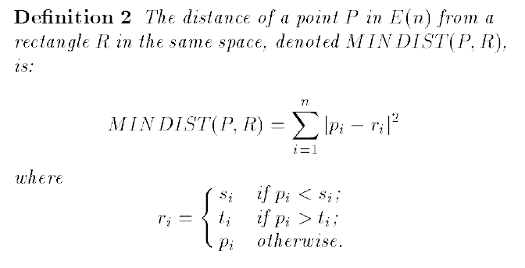
Min Distance(For nearest neighbour search)
1
2
3
4
5

Slide 11
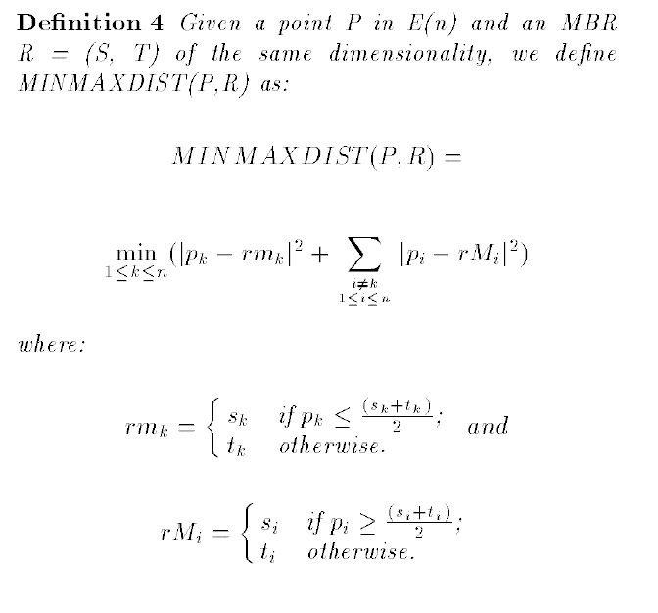
Min-Max Distance(For nearest neighbour search)
1
2
3
4
5

Slide 12
Nearest Neighbour Search
Pruning –
A MBR M with MINDIST (P,M) greater than the MINMAX DIST (P,M’) of another MBR M is discarded because it cannot contain the Nearest neighbor.
P
M’
M

Slide 13
Nearest Neighbour Search
Pruning –
The actual distance from P to a given object O which is greater than the MINMAX DIST (P,M) for an MBR M can be discarded because M contains an object O' which is nearer to P.
P
M
O

Slide 14
Nearest Neighbour Search
Pruning –
Every MBR M with MINDIST(P,M) greater than the actual distance from P to a given object O is discarded because it cannot enclose an object nearer than O.
P
O
M

Slide 15
Nearest Neighbour Search

Slide 16
Nearest Neighbour Search

Slide 17
AIM
Create 200 points from [-10, 10]¹⁰, i.e., the points come from a 10-dimensional space with the max values along any dimension lying between -10 and 10.
Construct an R-tree of different depths and given an arbitrary query point q find its nearest neighbour by searching through the R-tree.
Also check for which type of distance, viz., Euclidean, Manhattan or the L1 distance, is the returned nearest neighbour is actually the nearest neighbour of the given query point q.
If you increase the dimension from 10 to 20, do you still get comparable/useful results?
How easy is it to insert or delete a node?

Slide 18
Real Life Applications
Looking for Restaurants in your neighbourhood.
Navy ship looking for enemy submarines in its range.

Slide 19
Actual Code

Slide 20
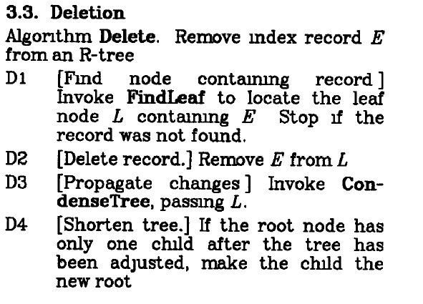
Deletion of a node

Slide 21
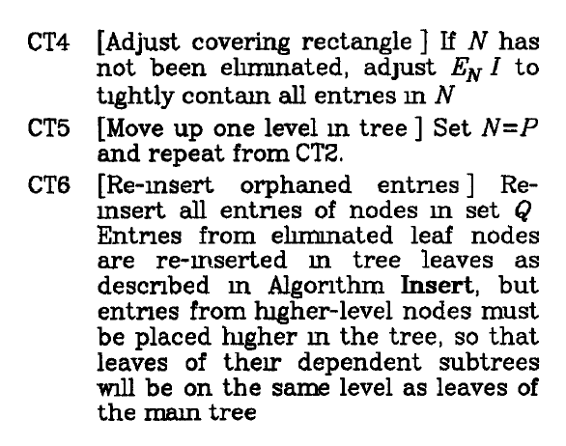
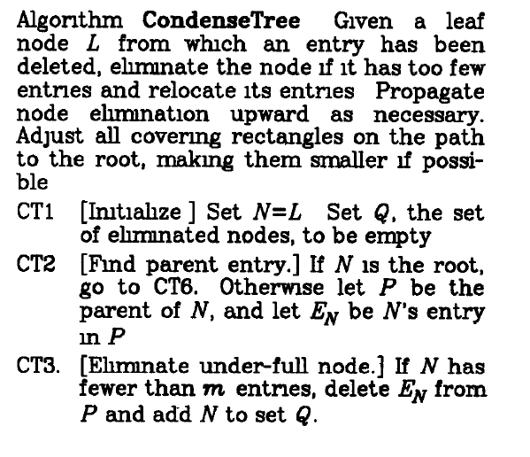
Deletion of a node

Slide 22
Deletion of a node

Slide 23
Challenges faced
Implementation Challenges- - Decision on the structure of node. As we have two possibilities of nodes, leaf(containing points) and non-leaf(containing Rectangles). - Splitting of nodes – As the brute force algorithm requires (2^m) operations we have used a sub-optimal quadratic time algorithm.

Slide 24
Credits
R-TREES. A DYNAMIC INDEX STRUCTURE FOR SPATIAL SEARCHING -Antonin Guttman University of California Berkeley
Nearest Neighbour Queries -Nick Roussopoulos Stephen Kelley Frederic Vincent Department of Computer Science University of Maryland College Park, MD 20742
R-tree – Wikipedia

Slide 25
Thank You

